Slide 1
Introduction to Labs
Jesús A. Omaña Iglesias jesusalberto.omana@upf.edu | Pablo Martín Castagnaro pablo.castagnaro@upf.edu

Slide 2
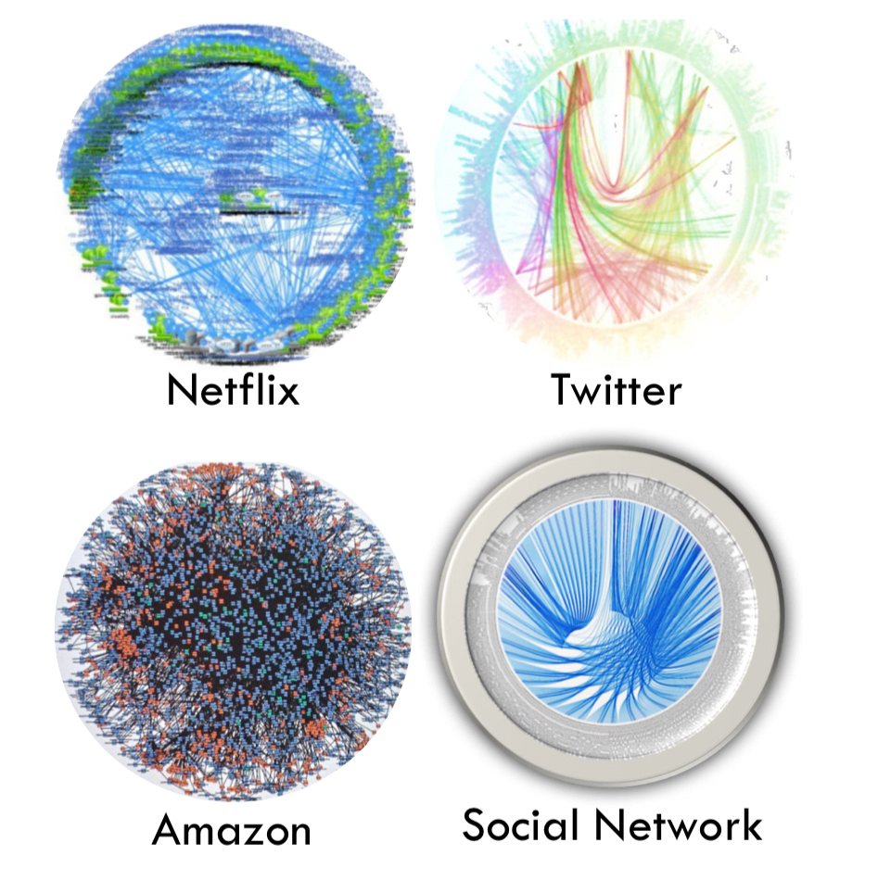
What is a distributed system? ”A set of cooperating computers communicating with each other over a network to get some computer task done.”
Single computer is always preferred
Many tasks can only be solved by distributed systems (e.g. large storage, big data computation)
Notes:
Example of computer tasks that required large storage and have to perform big data computation, hence, the need to solve it using distributed systems.
Figure shows the different services (imagine docker containers) and how they communicate with each other (deathstar benchmark)
Reasons for distributed computer
Parallelism
FAult tolerance

Slide 3
About me
(Jesús)
jesusalberto.omana@upf.edu
I have a job 🤓 Senior Research Scientist @ Telefonica Research
Contact: through email or forum

Slide 4
About me
(Pablo)
pablo.castagnaro@upf.edu
I work as Data Analytics Coordinator @ Boehringer Ingelheim Computer Systems Engineer @ UAI
Contact: through email or forum

Slide 5
About the course

Slide 6
Sixth edition
4 groups
6 sessions of 2h each
3 submissions
~3 week time per submission
Notes:
The 3 labs are approximately twice the size, in twice the time, so that you can better distribute the load

Slide 7
Feedback is always welcome
You can write on the forum or contact us by email at any point
Helps everybody

Slide 8
Resources
Lab workstations, virtual machine or your own laptop/resource
AWS Academy account

Slide 9
Course slides
Will be available in “Aula Global” (moodle) during the sessions

Slide 10

Ground Rules

Slide 11
Groups
3 people per group
(Groups of 2 are an exception only due to rounding)

Slide 12
Submission Delays
No delays

Slide 13
Not compiling submissions
Code that fails to compile will not be evaluated
Be sure that you submit all the required files!

Slide 14

Tooling

Slide 15
Language
Java

Slide 16
Builder
Maven

Slide 17
IDE
Anyone you want
Suggestions: Visual Code | Eclipse | IntelliJ

Slide 18
Collaboration
Aula Global
Ask questions. Clarify doubts. Answer other’s questions.

Slide 19
Collaboration
Is the key!

